Slide 1
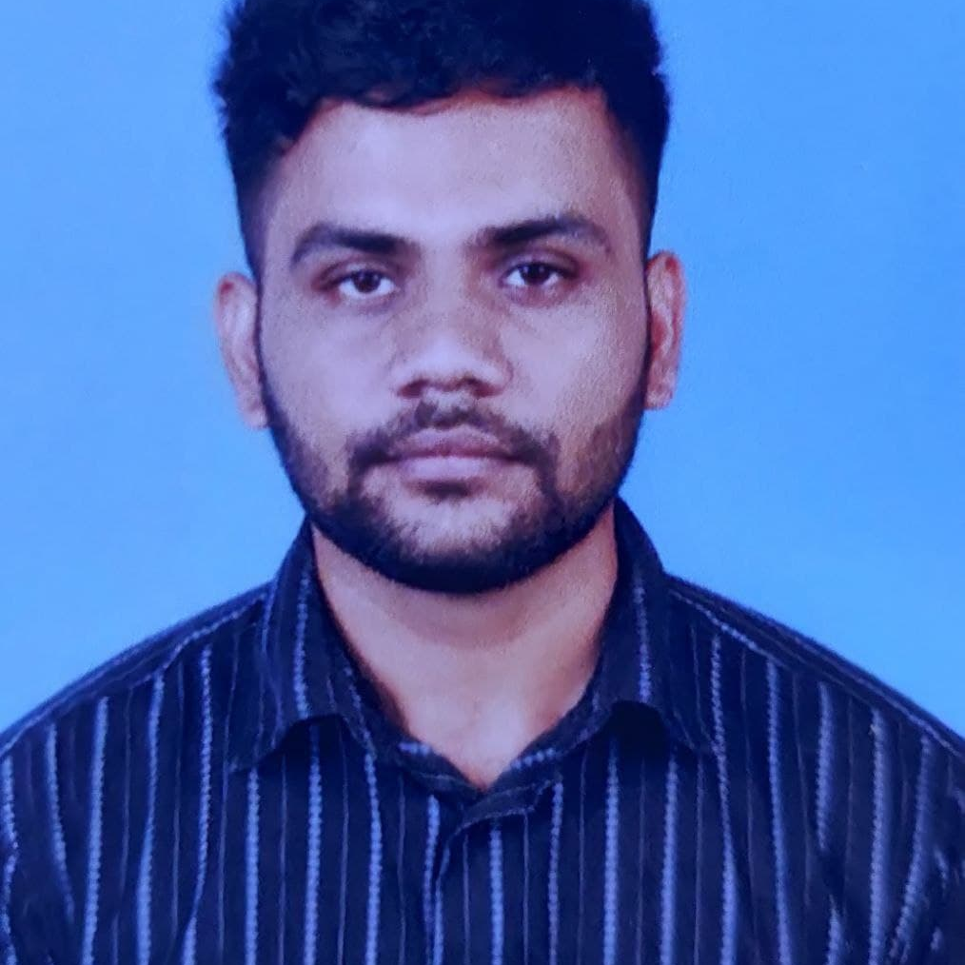
Kaveesh Kumar R R
Analyst/Software Engineer
Bachelor of Engineering
in Electronics And Communication: 2018 - 2022
Skills Java 8
Spring Boot
Spring MVC
JPA CRUD
Rabbit MQ
Docker
MERN Stack
ReactJS
MongoDB
Database
No SQL database – MongoDB
Web Technologies
HTML5
CSS3
Javascript
AddOns
Github
Maven
Postman
Additional Details
Excellent Communication Skills
Time management
Chennai
KAVEESH.KUMAR-RR@CAPGEMINI.COM
7094064904
A4
Software Engineer who has a lot of passion on Web Development, and always happy to implement new projects.
Now I am on the learning part of SQL Database.
Always a team member and ready to learn new technologies to improve myself day by day on this to work on various kinds of projects
Having working Knowledge on Java, REACT, Microservices and Spring Framework.
Ready to learn new technologies and implement them in future to improve knowledge
CROP DEAL Case Study
Completed end to end case study of Crop Deal Application with spring Boot, React and MongoDB along with JWT authentication, Swagger Junit testing and implemented testing using Mockito.
1)Software development in Python: A practical approach
2) Python Programming- From Basics to Advanced level
Completed the above mentioned courses
Completed AWS Certified Cloud Practitioner ( AWS CCP) Certification.
Completed Google Cloud Digital Leader (GCP CDL) Certification.

